Slide 1
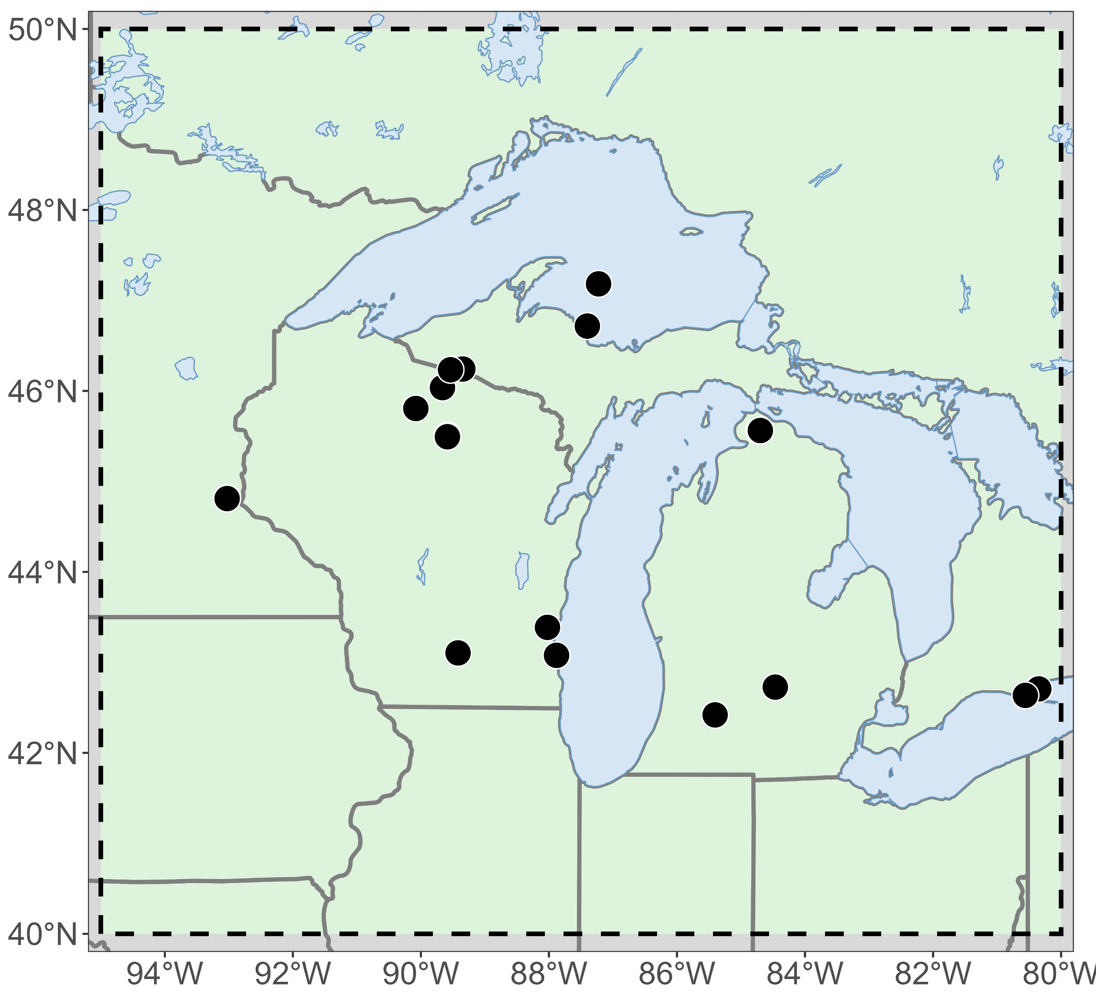
Warm winter climate drivers
Study domain
Higher air temperature
Warmer winter (DJFM)
ENSO influence
Less snowpack
Reduced snow cover
Less insulation
Great Lakes region
40–50°N, 80–95°W
Ecological processes and working hypotheses
Climate
NOAA, ENSO (ONI)
Less insulating snow promotes more variable and colder soil temperature
Phenology
NEON, PhenoCam, MODIS
Uniform earlier start of leaf development in spring
Soils
NEON, UMBS, KBS, AmeriFlux
More variable soil temperature promotes variable and greater carbon respiration
Ecosystem Fluxes
Ameriflux/FLUXNET
Wintertime NEE temperature sensitivity and basal NEE greatest during warm and wet winters
Aquatic biogeochemistry
USGS, NTL-LTER
Reduced peak streamflow due to lower snowpack and earlier peak streamflow; earlier lake stratification
Great Lake evaporation
NOAA GLSEA, Great Lakes evaporation network
Reduced heat loss and evaporation results in less ice cover
Whole domain:
Small mammals
NEON
Changes in diversity based on different strategies for winter survival.
Northern temperate to boreal transition forest, oak-savanna, agricultural regions, and extensive freshwater ecosystems
Synthesis and conclusions
How do ecological processes respond to warming winters?

Slide 2
Icons

